Slide 1
Hotel Guest Management System
Samson Tulu
https://github.com/SamTulu/Hotel-Guest-Management-System-.git

Slide 2
Problem Statement
There are still some hotels which operates using a stand alone application which requires guests to go in person to the hotel in regards of checking room or hall availability and price. This mechanism is not convenient because its unorganized in managing guest reservation , diminish in time management, creates low Customer attraction, and it’s not suitable for communicating with guests.

Slide 3
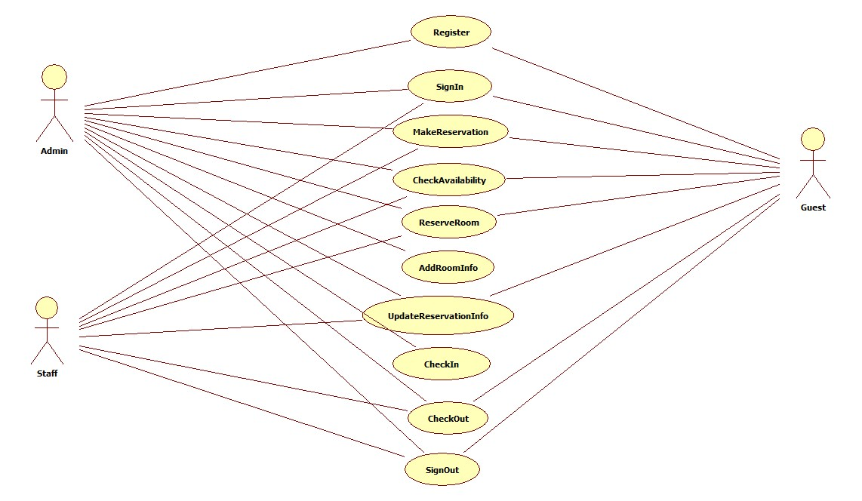
H.G.M.S Use Case Diagram

Slide 4
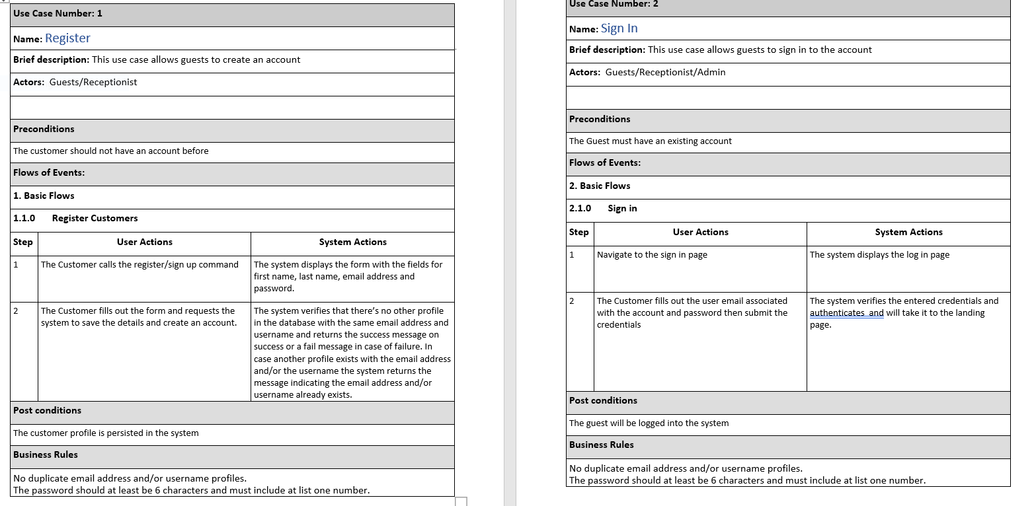
H.G.M.S Use Case Descriptions

Slide 5
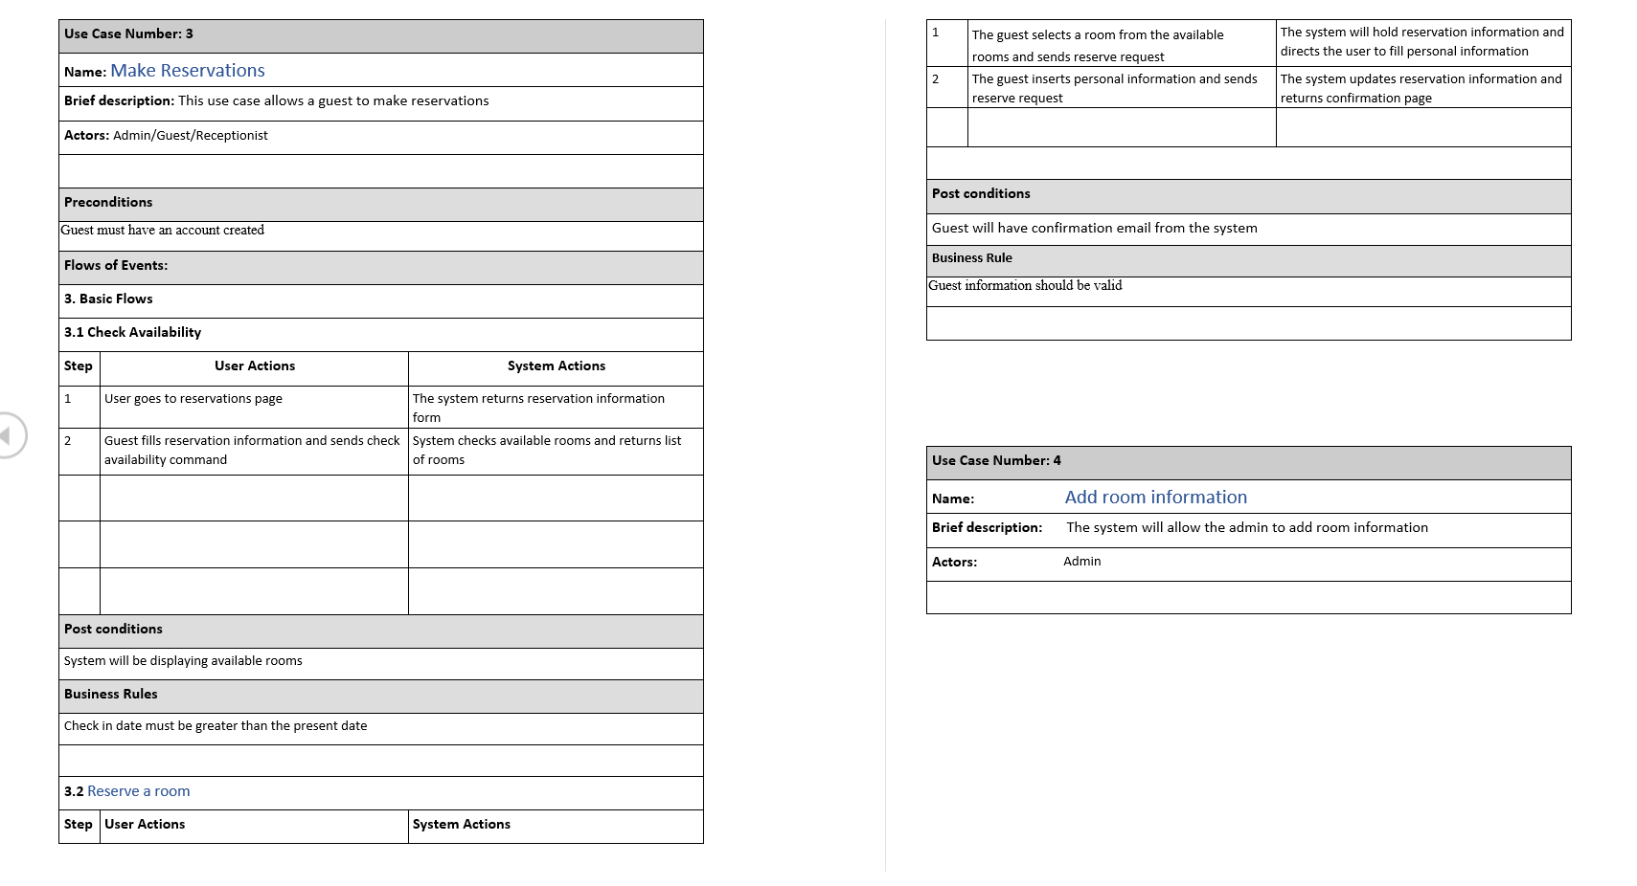
Continued …

Slide 6
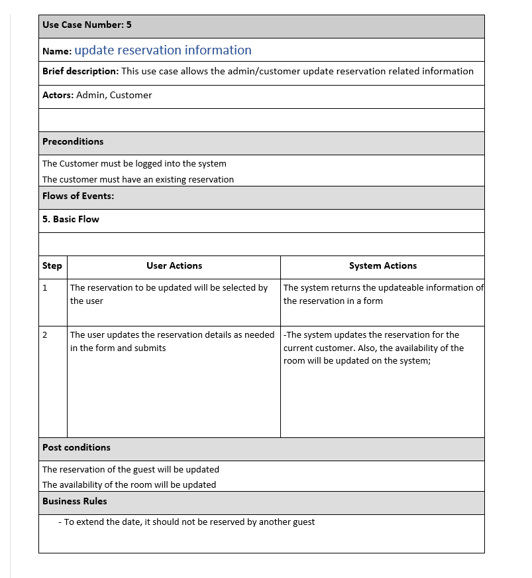
Continued …

Slide 7
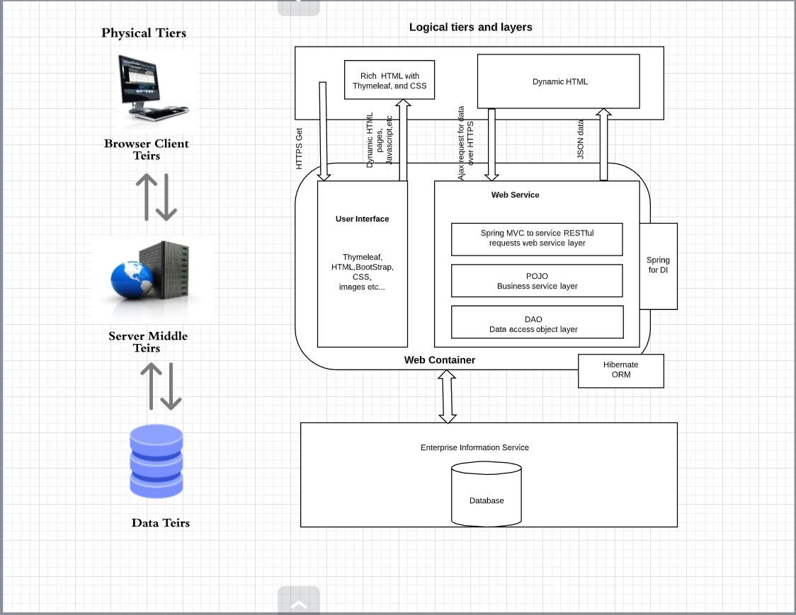
System Architecture Diagram

Slide 8
Key Abstractions
Admin/Staff
Guest
Room
Room Type
Reservation
Bill
Contact
Role
Address
Credentials

Slide 9
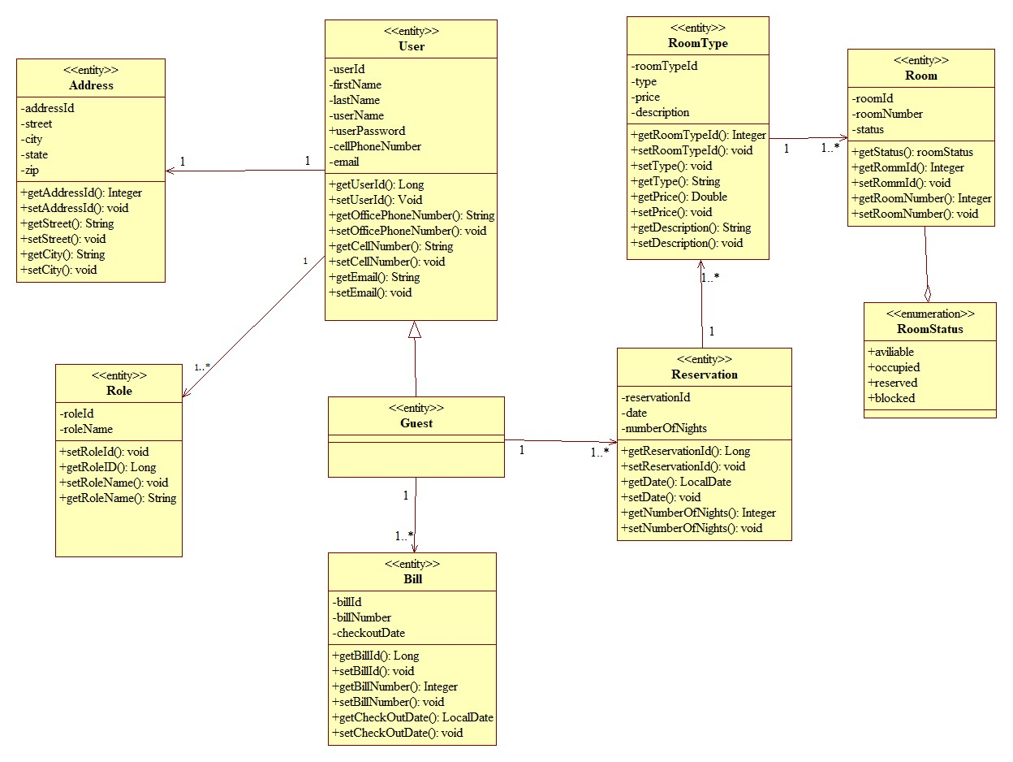
Domain Class Diagram

Slide 10
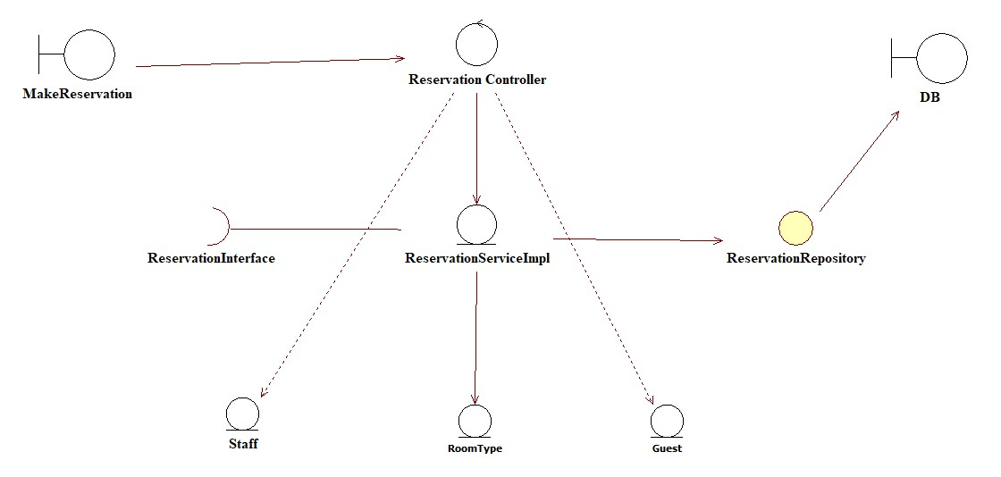
Reservation VOPC Diagram

Slide 11
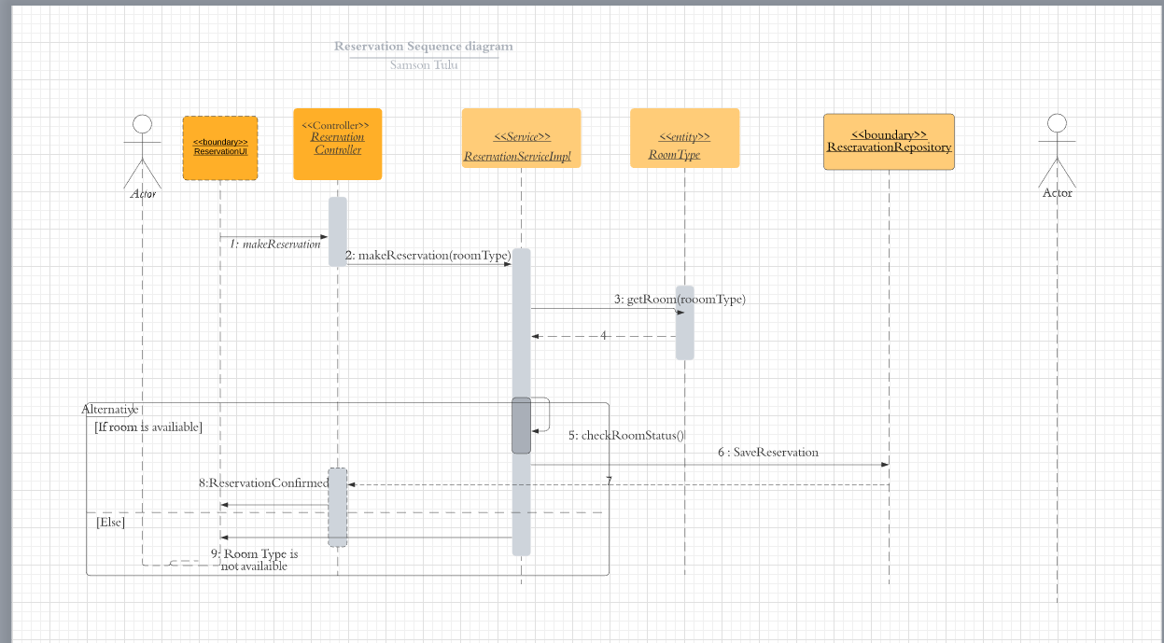
Reservation Sequence Diagram

Slide 12
Q&A?

Slide 13
Thank You!!

